Slide 1
Supplements for depression
This Photo by Unknown Author is licensed under CC BY
Hw-499 Amanda wright 3/29/22

Slide 2
Supplements for depression
Saffron
Omega-3 fatty acids
SAMe
ST. John’s wort
Notes:
Depression is classified as a mental health disorder that is often characterized by sadness, thoughts of emptiness or hopelessness, lack of energy, or interests, as well as other symptoms. While depression is usually mainly treated by therapy and or antidepressants, more and more people are looking outside the box for treatment of depression, as well as other health problems. There are many natural ways to help treat the symptoms of depression. Exercise has been linked with being in a better mood. Physical activity is good for body and mind but is not always easy to do. People that have taken antidepressants and did not do well on them, may be tempted to try a more natural pill to treat their depression. So, what are our options for this alternative? According to an article found on Healthline.com, there are several supplements that have been linked with helping to fight depression. Today we are going to talk about four of them. Saffron, omega-3 fatty acids, SAMe, ST. John’s Wort.

Slide 3
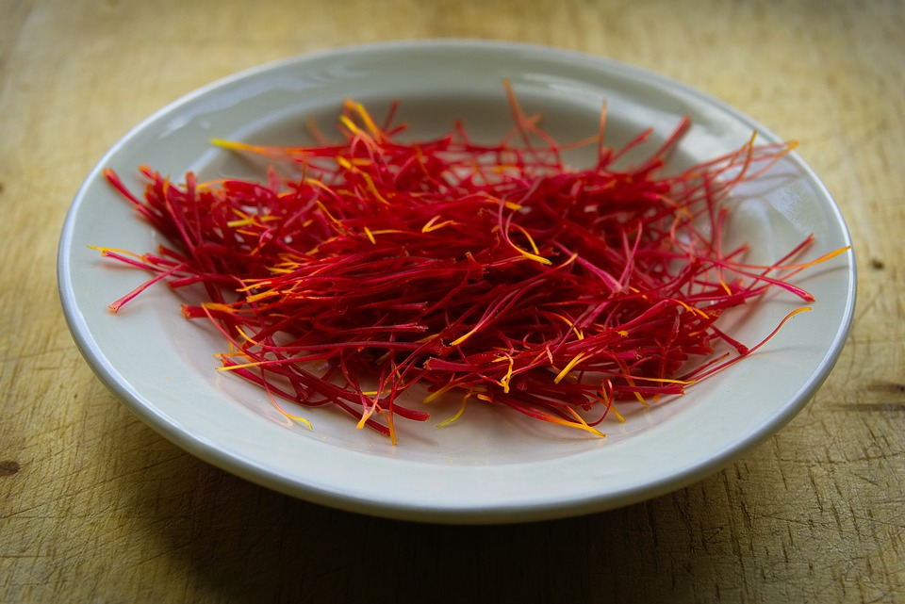
saffron
Major benefits to depression
Prozac vs Saffron
Safranal and Crocin
Dopamine and Serotonin
This Photo by Unknown Author is licensed under CC BY-ND
Notes:
Saffron is a spice made from crocus sativus, or the saffron crocus. It is native to Asia Minor and southern Europe. The center of the flower containing the red sticks called the stigma, is what is made into saffron spice. Most of the saffron in the world is produced in Iran (Facts and Comparisons).
Several studies have shown that saffron has major benefits to depression. It is thought that the compounds safranal and crocin in the plant could be helping depression as they keep dopamine and serotonin balanced. In 2007, Iranian scientists conducted a trial with 40 depressed adults. Each participant was randomly assigned to receive either a capsule of saffron at 15 mg in the morning and evening or Fluoxetine (Prozac) at 10 mg in the morning and evening for two months. Saffron was shown to have a near identical efficacy rate to Prozac in these patients (Feldman, 2017). More research is still needed to prove the efficacy of saffron as an antidepressant.

Slide 4
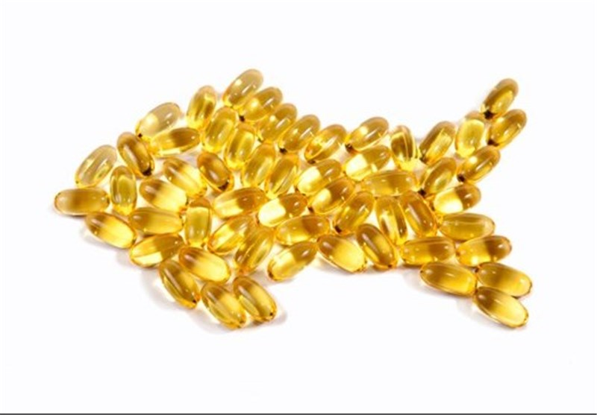
Omega-3 fatty acids
Post-partum depression
Schizophrenia
Seafood rich diet
Step 3 Title
Step 2 Title
Step 1 Title
This Photo by Unknown Author is licensed under CC BY
Notes:
Omega-3 fats are what is called a good fat. It is a fat we need from our diets. It can be found in fish, flaxseed, and flaxseed oil, walnuts, and more (Hall-Flavin, 2018). Most Americans get Omega-3 in the form of a supplement.
Omega-3 fatty acids have been found to be effective in reducing symptoms of depression (often tested using post-partum depression) and other psychiatric disorders including Schizophrenia (Wani et al., 2015). That meta-analysis shows that, although Omega 3 has sometimes found to be effective in the treatment of depression, other studies have found it has no measurable difference versus a placebo. The initial research into the link was interesting, as it focused on the impact of a seafood-rich diet on depression, which led to narrowing of research into the impact of Omega-3 on depression.

Slide 5
Sam-E
S-Adenosyl methionine
es-uh-den-o-sul-muh-THIE-o-neen
It is used to treats
Depression
Liver Disease
Osteoarthritis
Notes:
SAMe is a synthetic form of a naturally occurring sustenance in the body that helps produce and maintain hormones and cell membranes (Mayoclinic.com). Some research has indicated that SAM-e can be effective at treating depression, as well as liver disease, and osteoarthritis. It can be taken orally as a pill, injected intramuscularly, or given through an IV. SAM-e is generally safe to take when taken alone and not combined with other medications. As with any supplement, you should talk with your doctor and pharmacist before taking SAM-e because it can interact with some prescription medications as well as other supplements. Aside from causing some typical side effects, SAM-e can also cause serotonin syndrome in people that are taking antidepressants, antipsychotics, amphetamines, such as Adderall, narcotic pain medicines such as tramadol, dextromethorphan, a common cough suppressant, and ST. John’s Wort. It can decrease the effectiveness of levodopa, a prescription medication for Parkinson's disease (Mayoclinic.com).

Slide 6
St. john’s wort
A wildflower with deep roots in Europe
Used for depression
Mixed results on effectiveness
This Photo by Unknown Author is licensed under CC BY-SA-NC
Notes:
ST. John’s Wort has been used to treat depression and many other ailments for centuries. It is commonly used and prescribed in Europe. In the United States, it is sold as a dietary supplement, and therefore not regulated as much as prescription medications are. There have been many trials and studies on St. John’s Wort, some of which are compared with common antidepressants such as Citalopram, generic for Celexa, and Sertraline, generic for Zoloft. One study concluded that it and Citalopram were not effective at reducing symptoms of depression. One study indicated that it was more effective than the placebo, and as effective as the antidepressant, while another study concluded that it was similar in its effectiveness to Sertraline and a placebo (Nccih.nih.gov).
St. John’s Wort can interfere with other antidepressants, as well as many other medications. Always consult your doctor and or pharmacist before taking St. John’s Wort if you are taking other medications. St. John’s Wort can increase the likelihood of serotonin syndrome if taken with other antidepressants. It can also weaken other important medications such as birth control, anti-rejection medications for people who have had an organ transplant, certain heart and pain medications, some HIV drugs, a certain blood thinning medication, and even some cancer drugs (Nccih.nih.gov).

Slide 7
conclusion
Talk with your doctor and or pharmacist
Not FDA approved or regulated
Interactions
Depression is serious and should be treated as such
Notes:
In conclusion, please always talk to your healthcare provider and or pharmacist before adding a supplement to you diet or medication list. Your doctor and or pharmacist should always know everything you are taking to inform you and monitor you for adverse reactions. As with all supplements in the United States, they are not regulated as drugs, but as food. Some are not FDA approved at all. All of these supplements, as many more, can cause interactions with other antidepressants causing serotonin syndrome which is a serious condition. They can interfere with other serious and sometimes lifesaving medications, which is why it is important to talk with a healthcare provider before taking a new supplement.
Depression is a serious mental health condition that also affects your physical health as well. Many of these supplements have shown promise in short-term use, but more research is needed for its long-term use. Some supplements have also been shown to make certain other mental health conditions such as bipolar and schizophrenia worse. Over the counter supplements should not be used as a replacement or a postponement for seeking mental health treatment.

Slide 8
references
Feldman, E. (2017AD, August 1). Saffron and depression: What do we know and where do we go? Relias Media - Continuing Medical Education Publishing. Retrieved April 7, 2022, from https://www.reliasmedia.com/articles/141161-saffron-and-depression-what-do-we-know-and-where-do-we-go
Hall-Flavin, D. K. (2018, September 11). Natural remedies for depression: Are they effective? Mayo Clinic. Retrieved March 27, 2022, from https://www.mayoclinic.org/diseases-conditions/depression/expert-answers/natural-remedies-for-depression/faq-20058026
Kubala, J. (2021, July 30). 11 herbs and supplements to help fight depression. Healthline. Retrieved March 27, 2022, from https://www.healthline.com/nutrition/herbs-supplements-for-depression
Mayo Foundation for Medical Education and Research. (2020, November 18). SAM-e. Mayo Clinic. Retrieved April 8, 2022, from https://www.mayoclinic.org/drugs-supplements-same/art-20364924

Slide 9
references
Wani, A. L., Bhat, S. A., & Ara, A. (2015, September). Omega-3 fatty acids and the treatment of depression: A review of scientific evidence. Integrative medicine research. Retrieved April 7, 2022, from https://www.ncbi.nlm.nih.gov/pmc/articles/PMC5481805/
U.S. Department of Health and Human Services. (2017, December). St. john's wort and depression: In depth. National Center for Complementary and Integrative Health. Retrieved April 9, 2022, from https://www.nccih.nih.gov/health/st-johns-wort-and-depression-in-depth

